Slide 1







YVR Hackathon 2024
Sentinel of the nest
Presented by: VAMP
Presented to: YVR
Date: April 12, 2024
Abhilash Dikshit
Gunjan Paladiya
Murtaza Vora
Pradeep Sah
Vismay Viradiya
Swathi Raikwar

Slide 2

Land Acknowledgement
We would like to pay our respects to the Musqueam community, their elders, past and present, as well as future generations.
We acknowledge Vancouver International Airport (YVR) is located on the traditional, ancestral, and unceded territory of the Musqueam people.

Slide 3
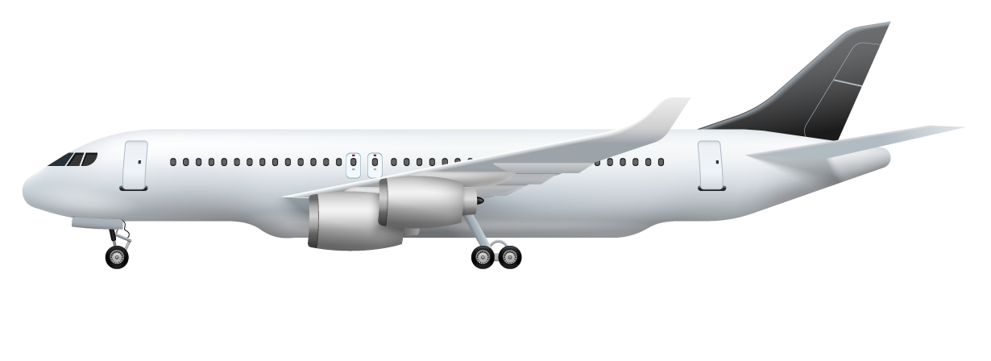
Facts at a glance
19 Million
284,404
319,032
Passengers served in 2023
Aircrafts flown in & out
Tonnes cargo moved

Slide 4
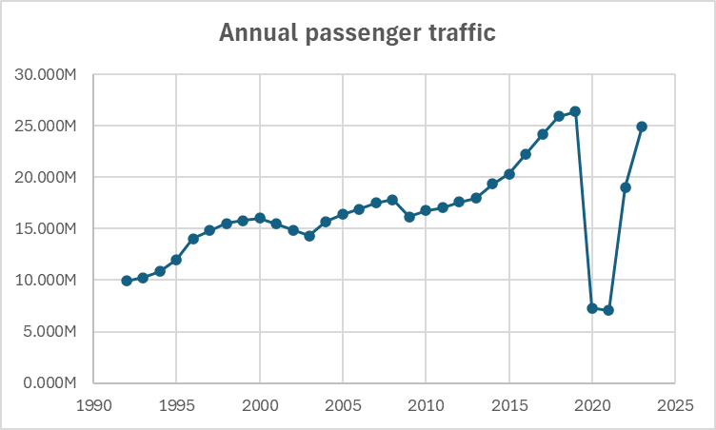
Predicted growth
2023
Passengers volume increased by more than 10 millions.
+31%
Growth compared to the 2022.
Data source : YVR - wikipedia page

Slide 5
Business Question: Crows Nest 2.0
Identify areas requiring attention from cleaning staff due to high traffic volume or observed waste and clutter
Detect unattended baggage, left belongings such as chargers, clothing, and anything else that may come to mind. Some poor facility standard example images included in this presentation

Slide 6
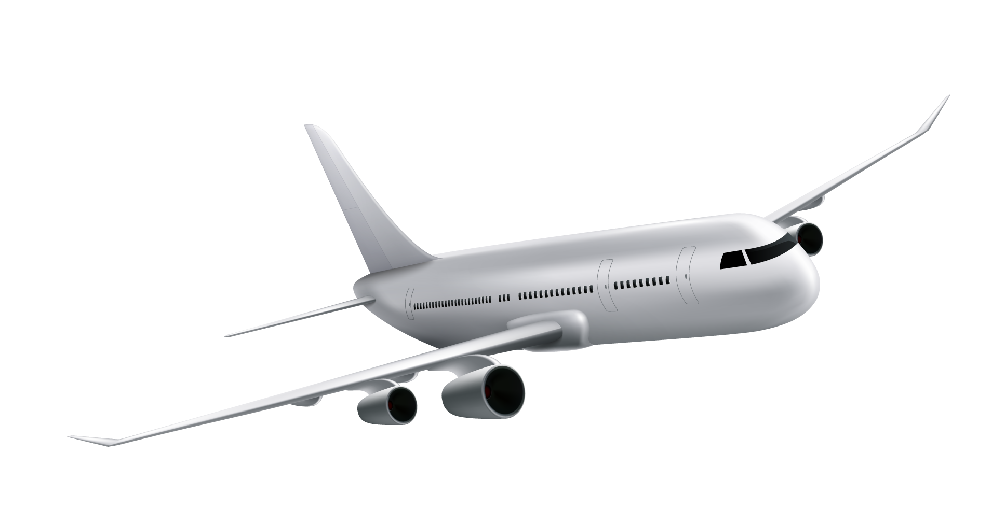
Proposed Business Process
Technology
Implication
Solving
YOLO + CV + AI + Brain
Analysis
Training
Need assessment of the solution
Custom AI model training

Slide 7

Solution - Sentinel of the Nest
Monitoring
Review
Analysis
Sentinel monitors public spaces using computer vision
Logs with detected classes, Prioritizes unattended items
Alerts staff for action
Reviews the camera feed, maps objects into 70+ classes

Slide 8

Real Time Passenger Tracking

Slide 9
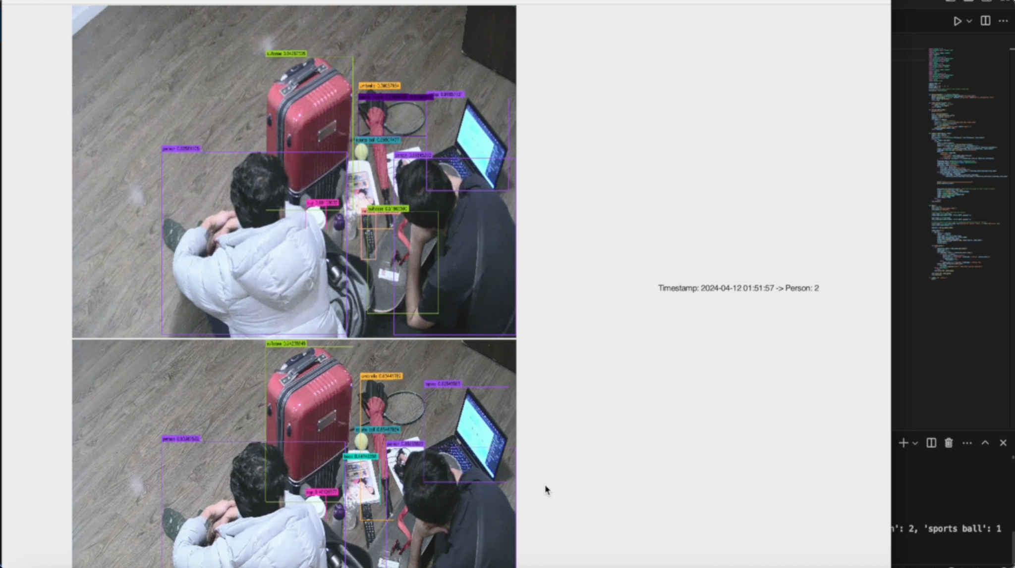

Slide 10
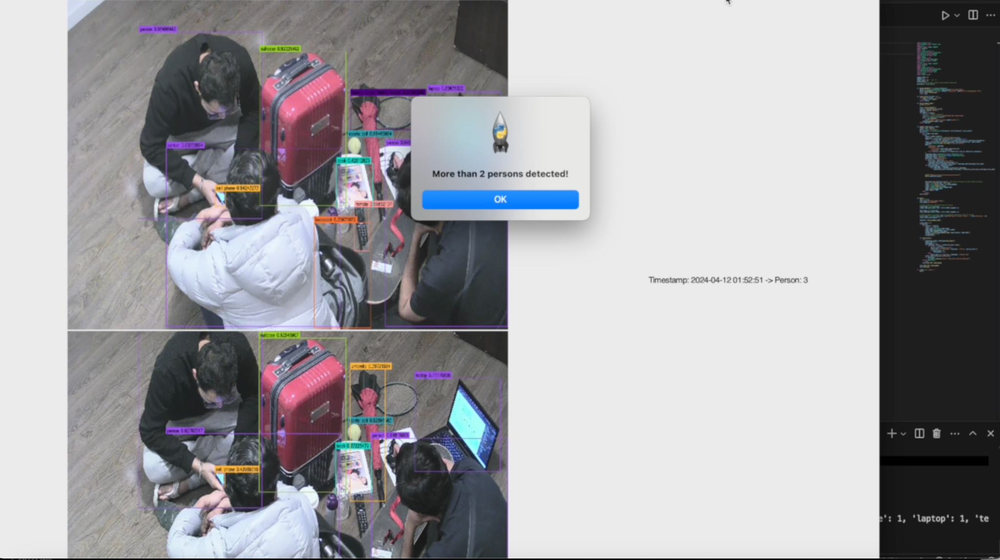

Slide 11
Real Time Passenger Tracking Algorithm
Generate logs
Custom triggers
Real Time logging in JSON
Here we
make decisions
Get the feed
Apply the YOLO and show
Inject camera view in the system
Detect the objects using cutting edge YOLO V9

Slide 12
Custom Triggers
Heat control
Light control
Customer service
Control the section heat as per the volume of the passengers coming in or going out from the specific locations.
For the better visibility and energy efficiency, automatic light and ambience controls,
Improved and designated customer services to the in the timely manner and at the required spots.
Improved energy efficiency of the appliances of the terminal and
value addition in the customer service

Slide 13

Garbage detection algorithm
Find custom dataset
Fine tune pre-trained model
Classification of the type of waste
Detecting the object from the video

Slide 14
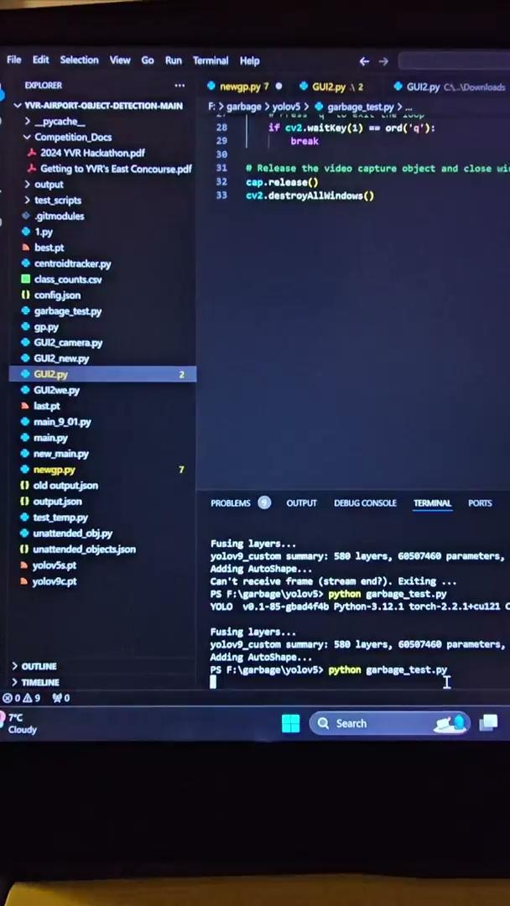
Garbage detection

Slide 15

Unattended Baggage Tracking
Unattended baggage tracking

Slide 16
Unattended object detection algorithm
Checking if the person is near the object
Masked unattended object
Highlighting the unattended object
Waiting for the threshold to trigger
Camera feed
Object detection
Inject camera view in the system
Detect the objects using cutting edge YOLO V9

Slide 17
Unattended object detection algorithm
Camera feed
Object detection
Inject camera view in the system
Detect the objects using cutting edge YOLO V9
Checking if the person is near the object
Masked unattended object
Highlighting the unattended object
Waiting for the threshold to trigger

Slide 18
Unattended object detection
Key Objectives:
Area Analysis: Automatically detect unattended objects and report them to the relevant authorities .
Security: Detects unattended baggage and belongings like book, bottles, and more, enhancing airport safety and security.

Slide 19
Real Time analysis
Input source - live video feed
Frame processing - YOLOv9e
Object detection
& annotation
Priority Calculation
Unattended object
detection
Object classification
Output Generation Logs
Monitoring and Logging

Slide 20
Live feed detection & Logging using YOLOv9-e
Key Objectives:
Area Analysis: Identifies high traffic zones requiring immediate attention due to waste accumulation or clutter.
Security: Detects unattended baggage and belongings and setting priorities.

Slide 21
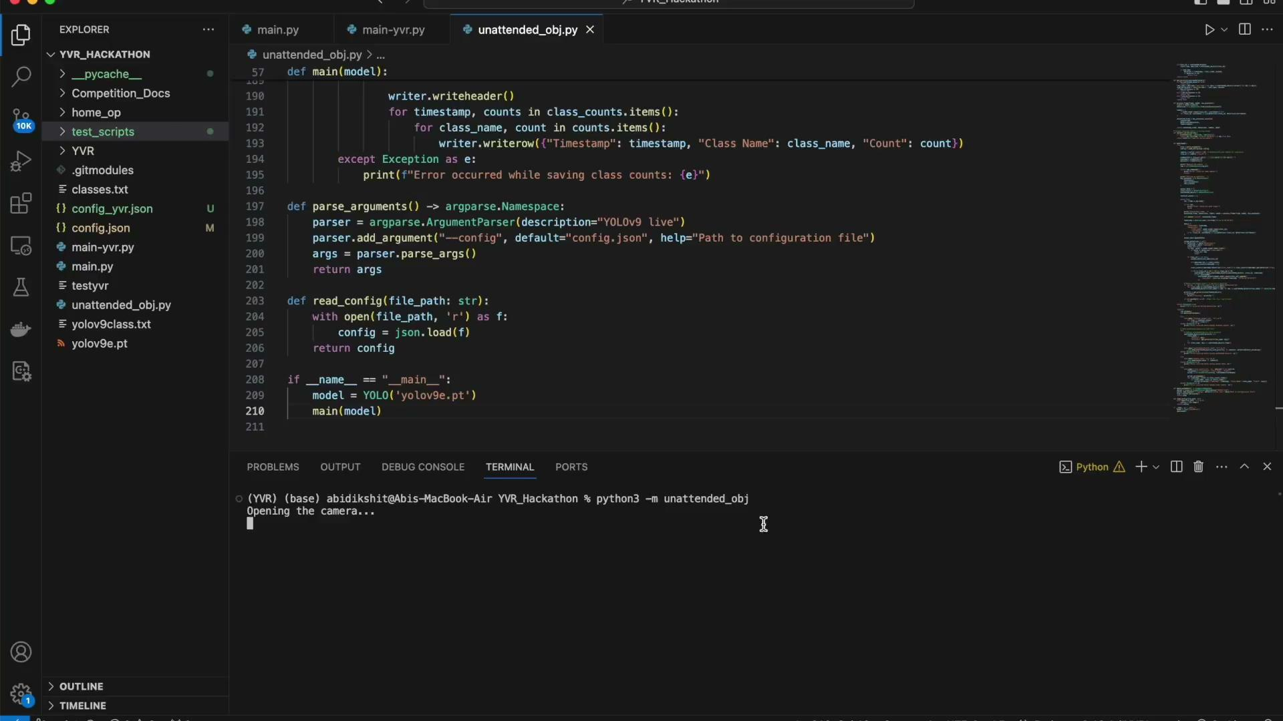
Live feed detection & Logging using YOLOv9-e

Slide 22
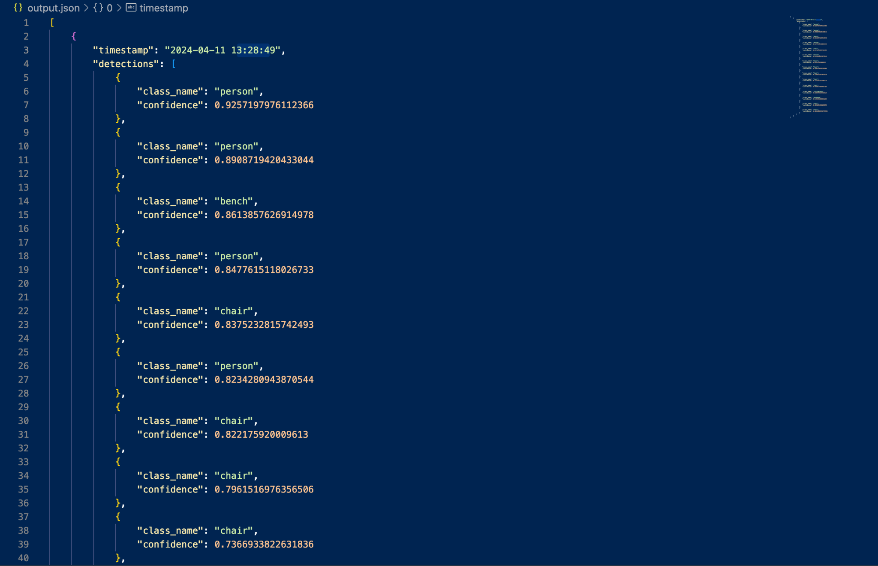
Log file for object detection: Nested json

Slide 23
Live Demo

Slide 24
Future Scope
System Integration
Advanced Analytics with Voice Control
Monitoring Area Expansion
Scope: Link YOLOv9e with baggage, check-in, and display systems.
Plan: Collaborate with IT to integrate APIs for better efficiency and passenger experience.
Scope: Use YOLOv9e data for predictive analytics on security and maintenance.
Plan: Develop models to forecast and mitigate risks.
Scope: Expand detection to lounges, entry/exit points, and gates.
Plan: Conduct feasibility studies and upgrade necessary infrastructure for faster object detection.
Law Enforcement and Emergency Services Collaboration
Feedback and Improvement
Detection Enhancement with more training and customized classes
Scope: Improve detection accuracy, especially for subtle or varying conditions. Also factor in emotion detection for public safety.
Plan: Regularly update the model with diverse training datasets.
Scope: Aid law enforcement and emergency services with real-time data.
Plan: Set up secure communication protocols for data sharing during incidents.
Scope: Establish a feedback loop for continuous system improvement.
Plan: Implement a feedback system and hold regular review meetings.

Slide 25
Resources
Raza, A. (2024, March 25). Unveiling YOLOV9: Revolutionizing Real-Time Object Detection. Medium. https://medium.com/@ahadrazadev/unveiling-yolov9-revolutionizing-real-time-object-detection-b688882a6da7
Cheng, W. L. (n.d.). YOLOV9 - a comprehensive guide and custom dataset Fine-Tuning. https://www.datature.io/blog/yolov9-a-comprehensive-guide-and-custom-dataset-fine-tuning
Singh, S. (2024, February 20). Airport 4.0: The future of airports takes flight. Forbes. https://www.forbes.com/sites/sarwantsingh/2024/02/09/airport-40-the-future-of-airports-takes-flight/?sh=737adece48d6

Slide 26

Question and answer!

Slide 27
Appendix

Slide 28
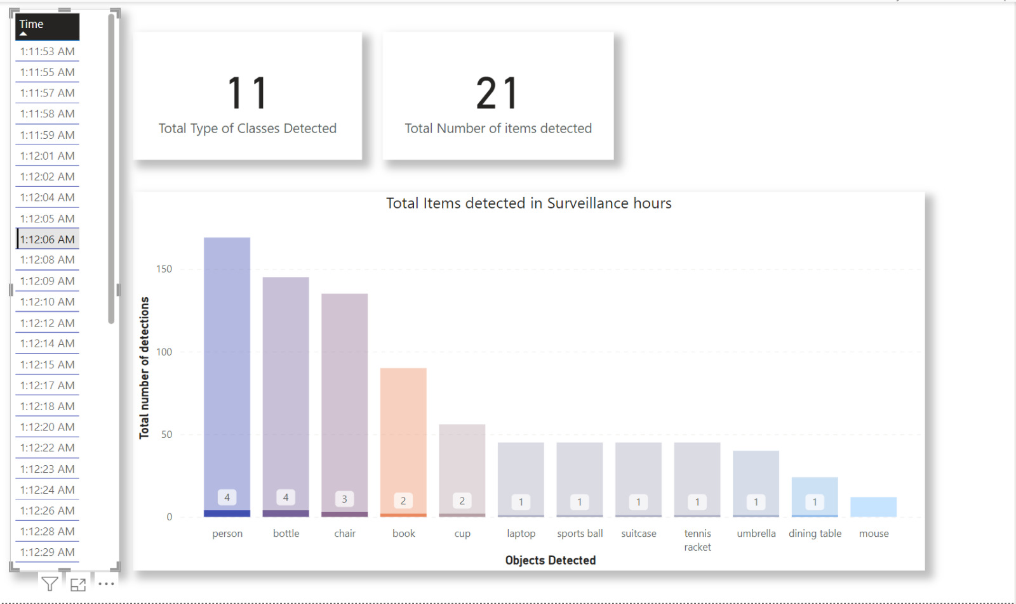
Data Analysis

Slide 29
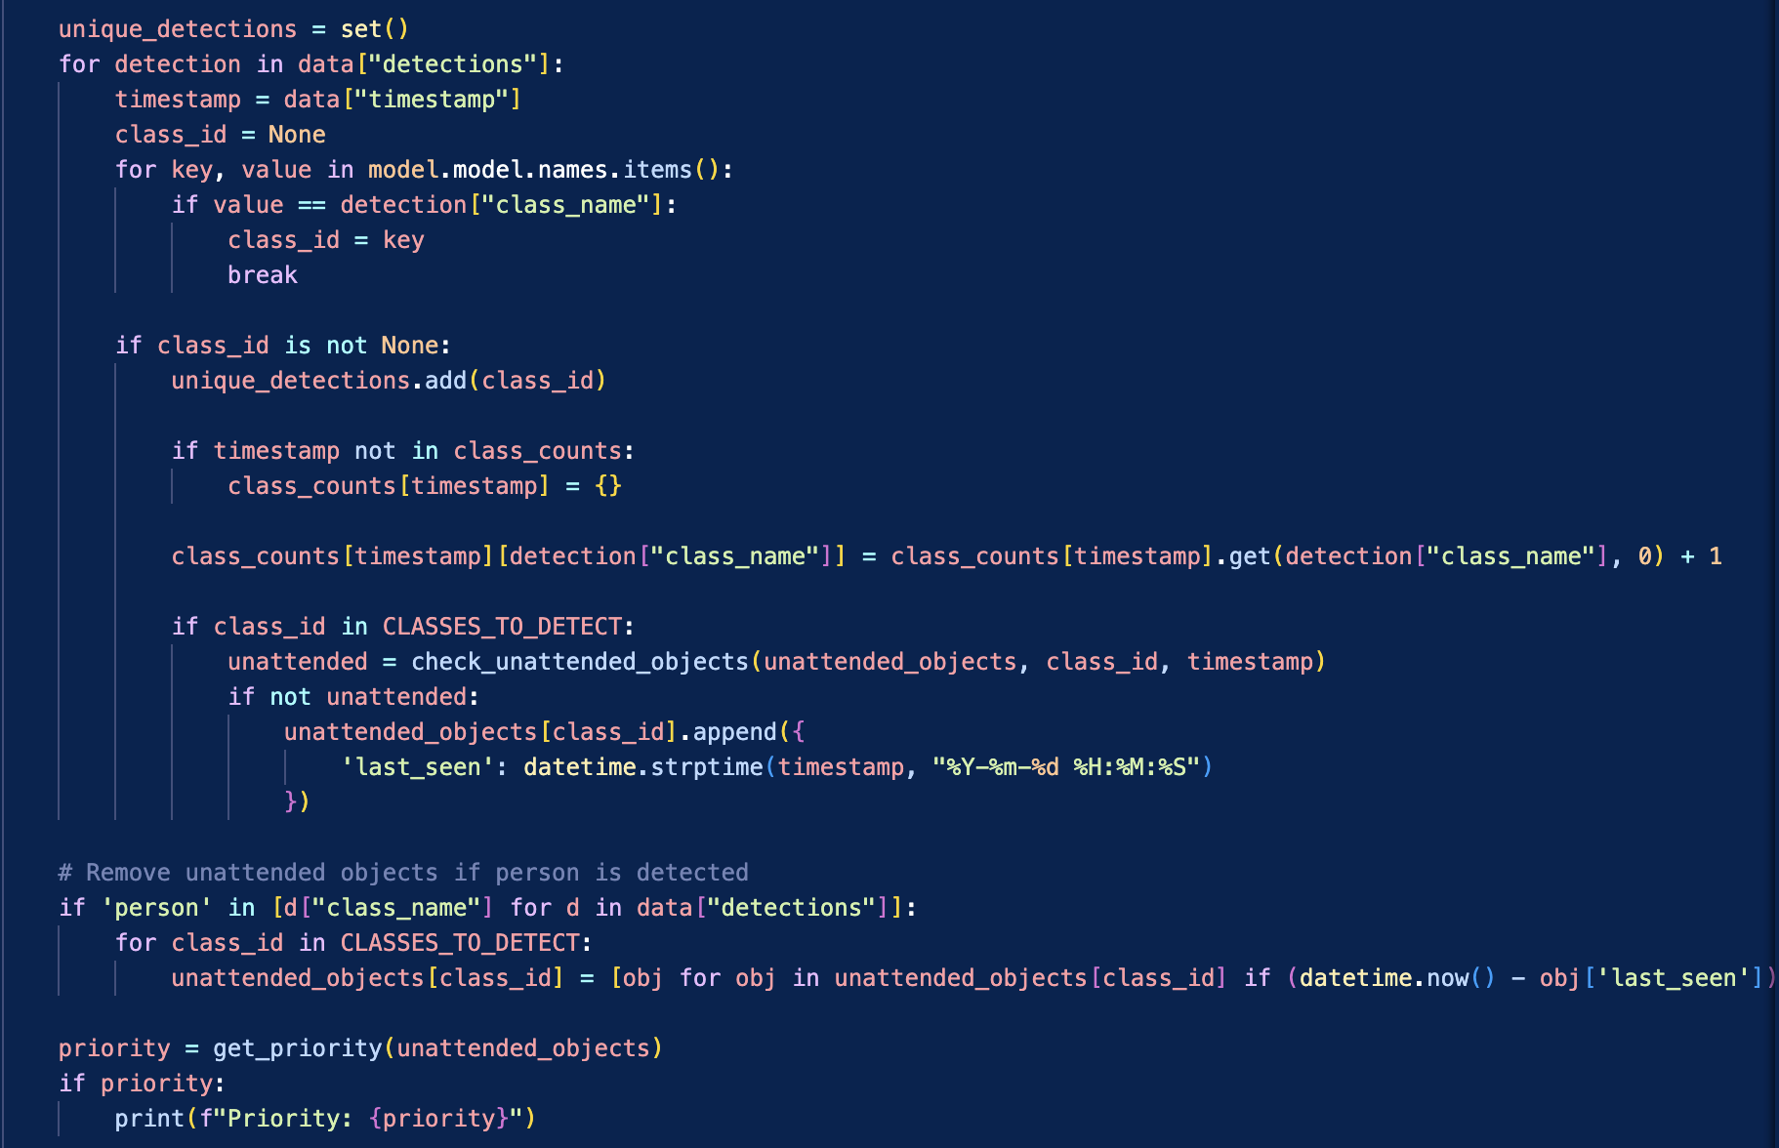
Log file code based on Priority for unattended items

Slide 30
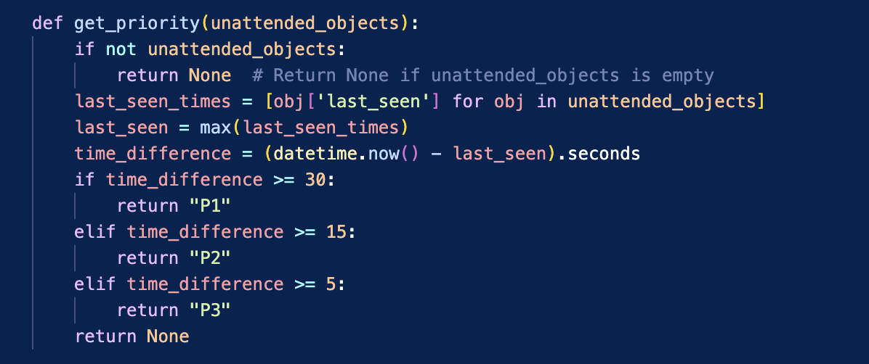
Unattended object algorithm

Slide 31
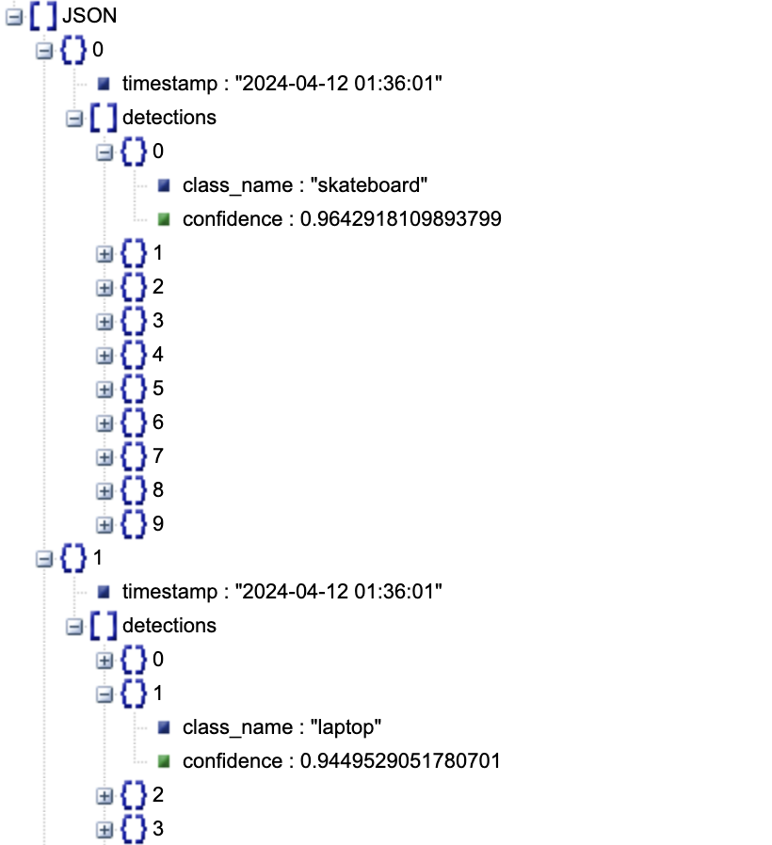
Log file for object detection: Confidence value

Slide 32
Let’s See The Airport Through VAMP

